Slide 1


Variables
Chris Piech
CS106A, Stanford University

Slide 2
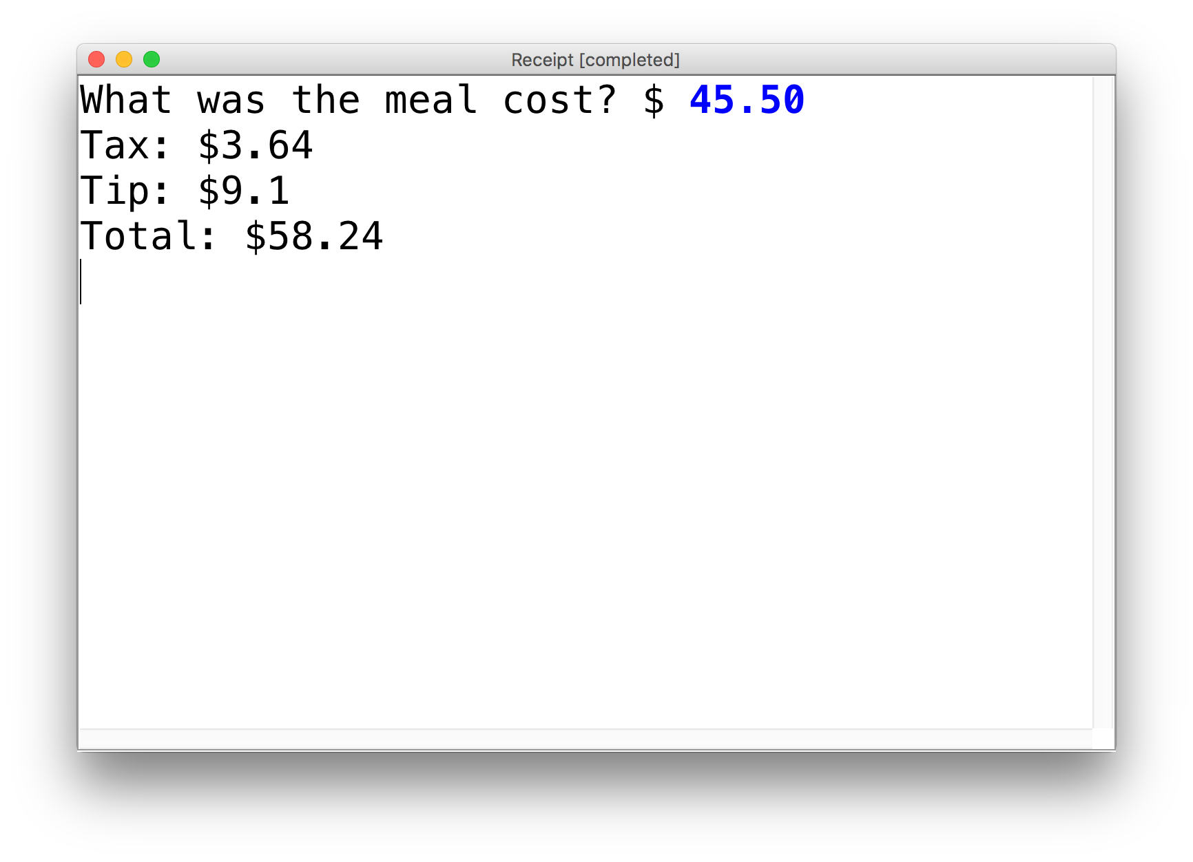
New Ability
Write a program that calculates the tax, tip and total bill for us at a restaurant.
The program should ask the user for the subtotal, and then calculate and print out the tax, tip and total.

Slide 3
Play Along

Slide 4
Review: Decomposition
Each method solves one ”problem”
Methods should have good names
Comment each of your methods
Length of methods should be < 15 lines
Methods should ideally be generalizable
Notes:
He looks like an old machintosh machine.
Hes got legs… one sticks out the back. That’s just the way it is.

Slide 5
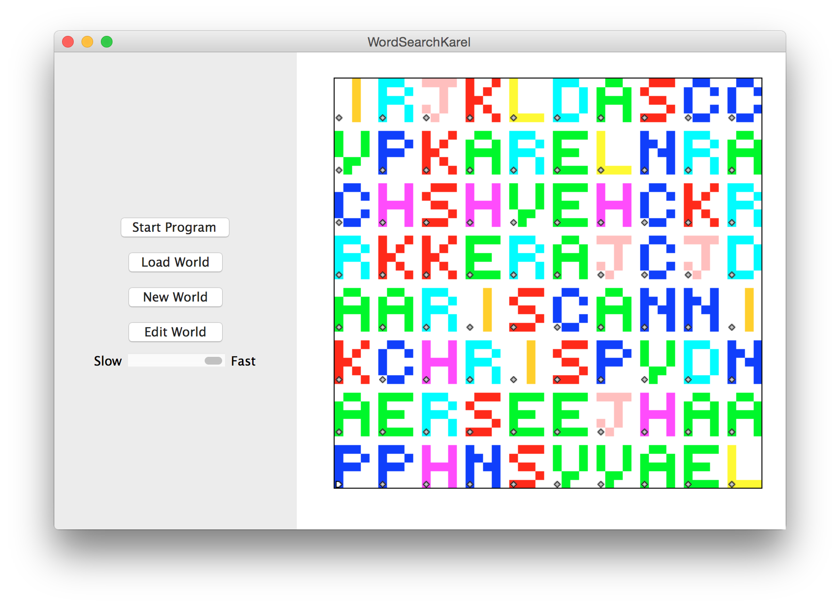

3

Slide 6
Decision 2018

Slide 7
Decision 2018

Slide 8


See You Later!
I will miss you.
Enjoy Java!
See you on the midterm .

Slide 9

Java

Slide 10
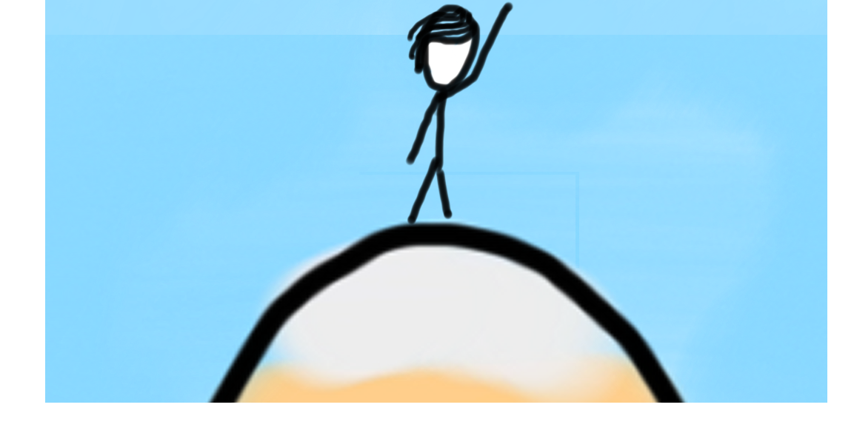

Today’s Goal
How do you make a memory box?
How do you see what is in a box?
What can you put in a box?
How do you change what is in a box?

Slide 11
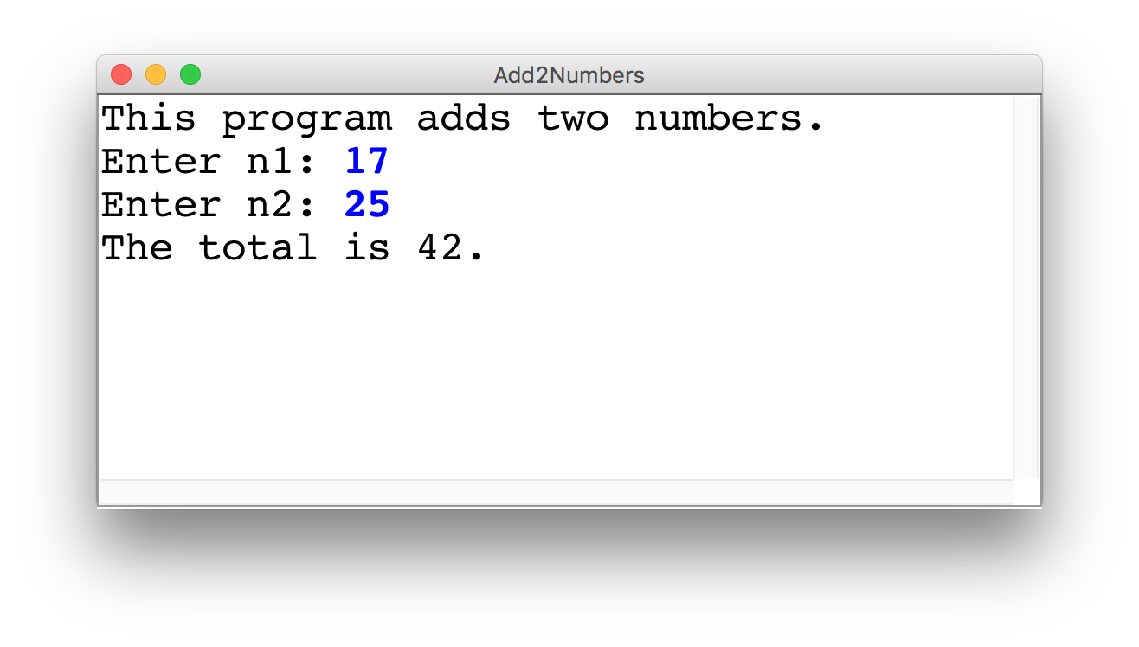
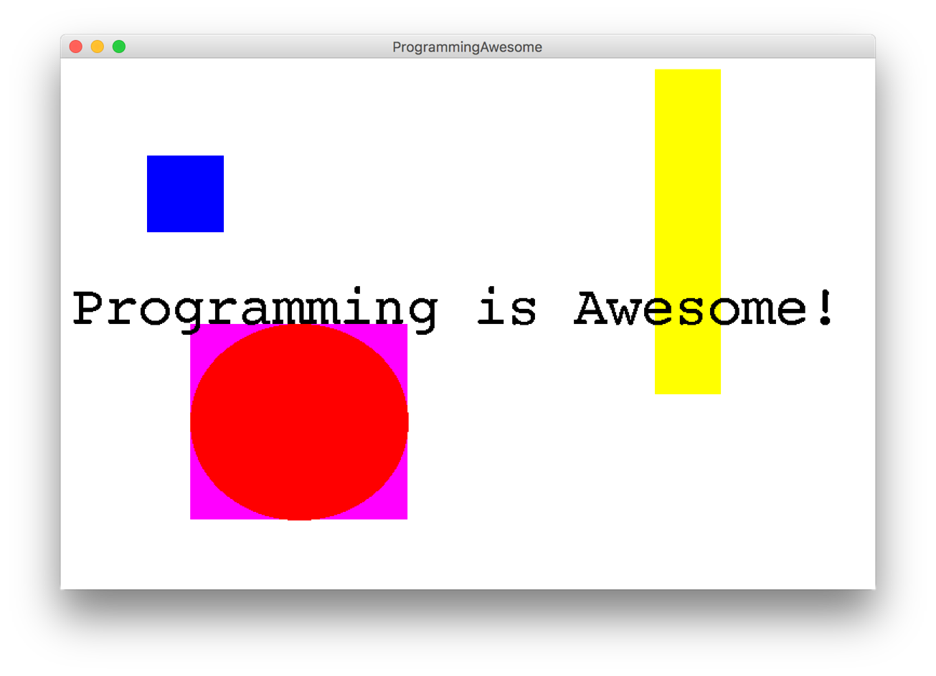
Two Example Programs

Slide 12
Types of Programs
Program
Console Program
Graphics Program
Karel Program

Slide 13

First Console Program: Hello World
import acm.program.*;
public class HelloProgram extends ConsoleProgram {
public void run() {
println("hello, world");
}
}
HelloConsole
hello, world

Slide 14
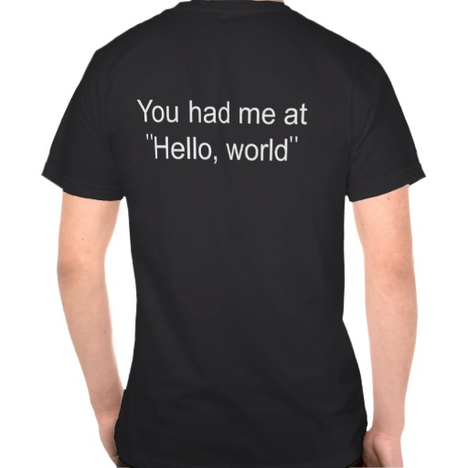

In Pop Culture

Slide 15
Add2Integers
class Add2Integers extends ConsoleProgram {
public void run() {
println("This program adds two numbers.");
int n1 = readInt("Enter n1: ");
int n2 = readInt("Enter n2: ");
int total = n1 + n2;
println("The total is " + total + ".");
}
}
n1
n1
n2
n2
total
total
17
17
25
25
42
42
Add2Integers
This program adds two numbers.
Enter n1:
17
Enter n2:
25
The total is 42.

Slide 16


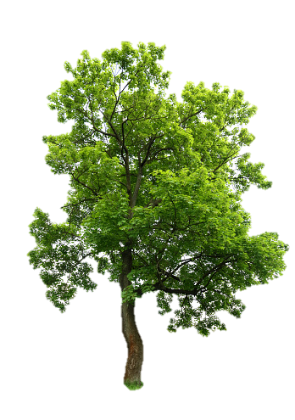
Today’s Route
You are here
Examples
Modify
Assign
Access
Variables
The River of Variables

Slide 17
Programs are control flow and variables

Slide 18
What is a variable?

Slide 19
[suspense]

Slide 20
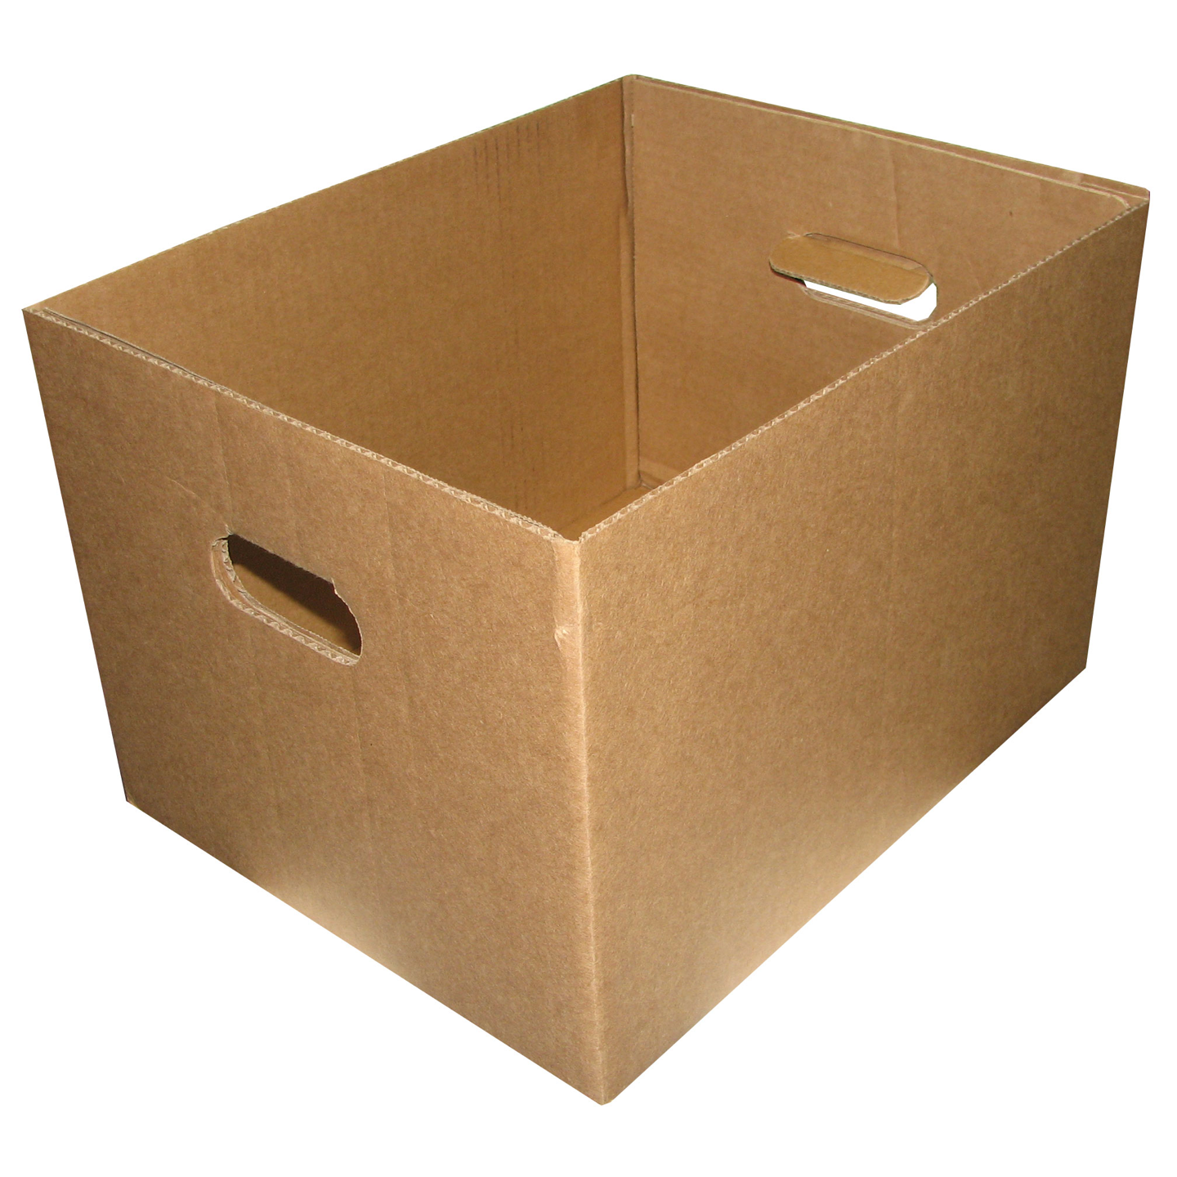
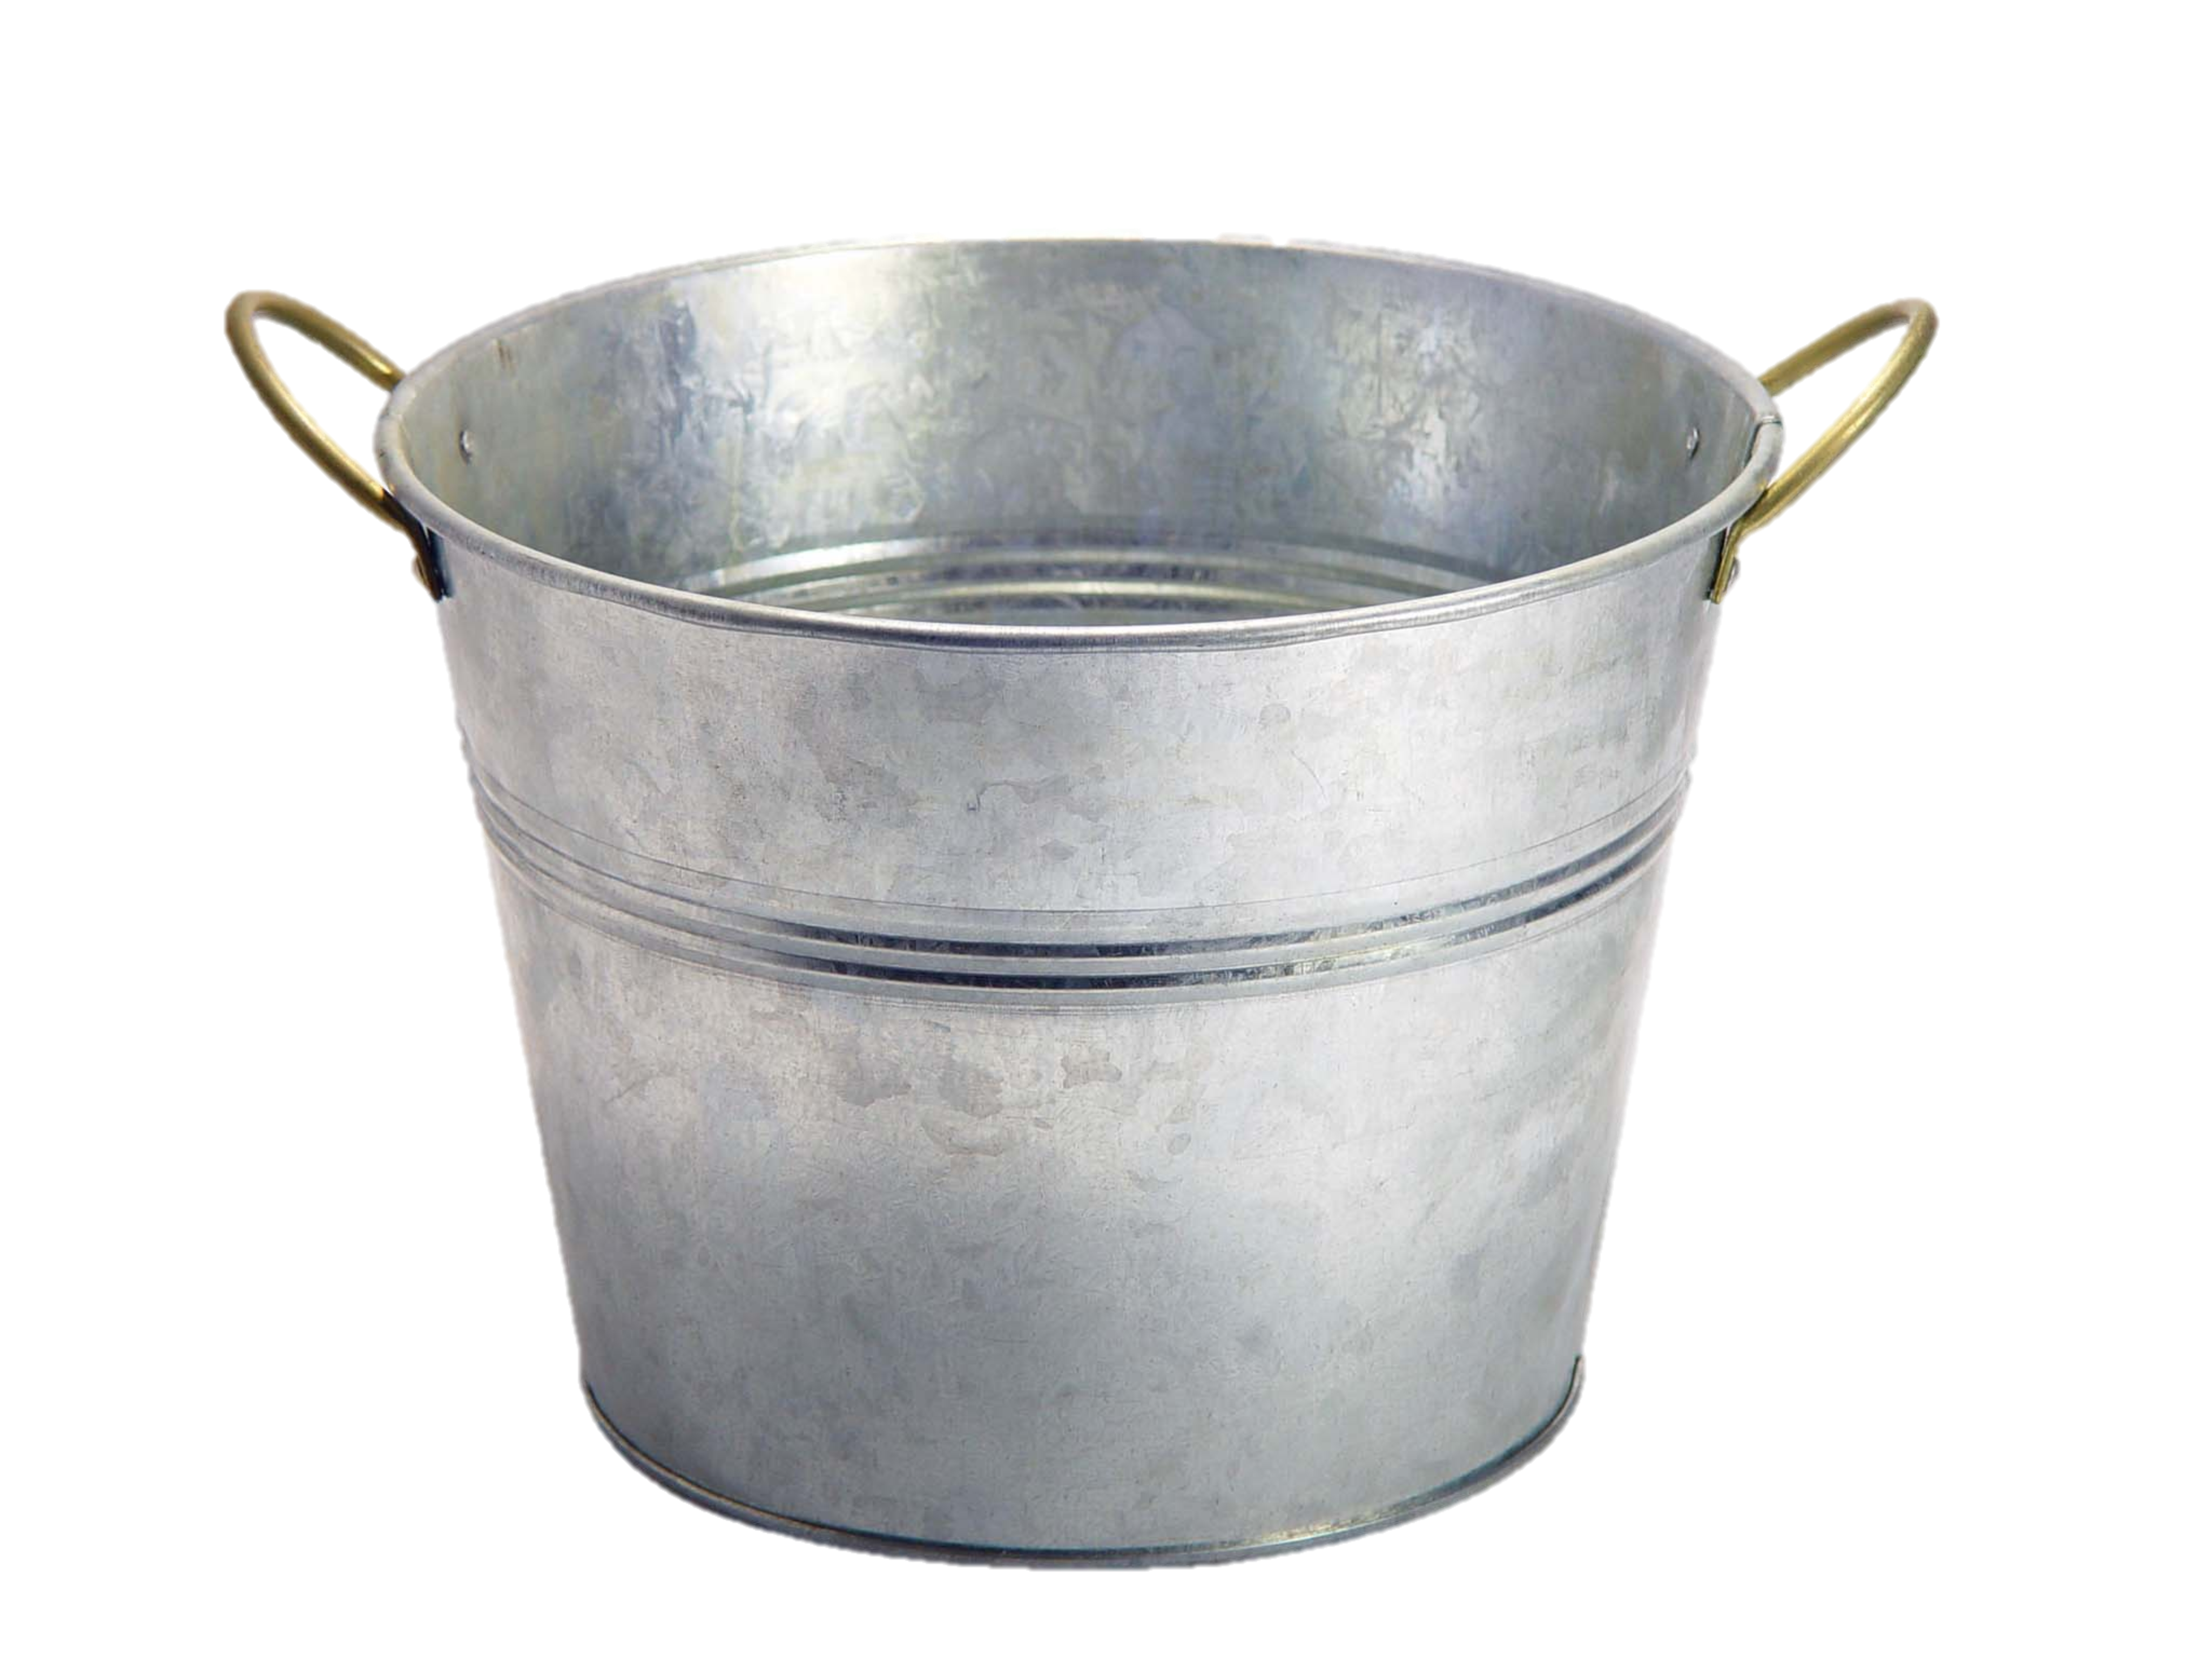
Variables are Like Boxes

Slide 21

Teeny Tiny Boxes
My computer has space for about 2 billion boxes

Slide 22
Making a New Variable
int age = 29;

Slide 23
Making a New Variable
type
name
int age = 29;
Initial value

Slide 24
Three Properties
name
type
age
29
(contains an int)
value
Notes:
Type name = value

Slide 25

Declaring a Variable
When a line starts with a variable type, it is creating a new variable …aka a box.
Example:
int myBox = 5;

Slide 26
Core Types
// integer values
int num = 5;
// real values
double fraction = 0.2;
// true or false
boolean isLove = true;
* Why is it called a double?

Slide 27
Core Types
// letters
char letter = ‘c’;
// “strings” of letters
String phrase = “Spring rocks!”;

Slide 28
Core Types
// integer values
int num = 5;
// real values
double fraction = 0.2;
// true or false
boolean isLove = true;
* Why is it called a double?

Slide 29
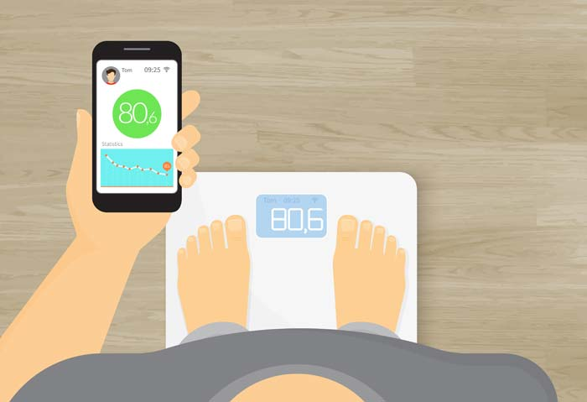
Double: How Much Do I Weigh?
* Answers could be real valued numbers

Slide 30
Int: How Many Children Do I Have?
* It is weird to say something like 1.7

Slide 31
Lots of Boxes
public void run() {
// integer values
int age = 30;
// real values
double weight = 180.2;
}

Slide 32
Can you access the value in a variable
(aka box)?

Slide 33
Outputting Variable Value
// creates a variable called
// age with the value 30.
int age = 30;
// puts the value of the age
// variable on the screen.
println(age);
* Fun fact. Chris turns 30 on April 25th

Slide 34
Fancy Output
// creates a variable called
// age with the value 30.
int age = 30;
// puts the following on the
// screen
// age is: <value>
println(“age is: “ + age);

Slide 35
What data can you put in a variable
(aka box)?

Slide 36
Add2Integers
class Add2Integers extends ConsoleProgram {
public void run() {
println("This program adds two numbers.");
int n1 = readInt("Enter n1: ");
int n2 = readInt("Enter n2: ");
int total = n1 + n2;
println("The total is " + total + ".");
}
}
n1
n1
n2
n2
total
total
17
17
25
25
42
42
Add2Integers
This program adds two numbers.
Enter n1:
17
Enter n2:
25
The total is 42.

Slide 37
Making a New Variable
type
name
int myBox = user input;
Initial value

Slide 38
Making a New Variable
type
name
int myBox = expression;
Initial value

Slide 39
Values from User Input
// Prompts user for a whole number. Stores
// result in a variable (aka a box)
int kids = readInt(“How many children?”);
// Prompts user for a decimal number. Stores
// result in a variable (aka a box)
double tip = readDouble(“Tip? $”);
// Haven’t you ever wondered, who was the first
// person to eat a carrot???
boolean edible = readBoolean(“Subject alive?”)

Slide 40
Add2Integers
class Add2Integers extends ConsoleProgram {
public void run() {
println("This program adds two numbers.");
int n1 = readInt("Enter n1: ");
int n2 = readInt("Enter n2: ");
int total = n1 + n2;
println("The total is " + total + ".");
}
}
n1
n1
n2
n2
total
total
17
17
25
25
42
42
Add2Integers
This program adds two numbers.
Enter n1:
17
Enter n2:
25
The total is 42.

Slide 41
Binary Operators
+
Addition
*
Multiplication
–
Subtraction
/
Division
%
Remainder
See you another day, tio.

Slide 42
Learn by examples

Slide 43
Order of Operation
// Mult before addition first!
int result = 4 + 2 * 3;
// 10
// Left to right!
int sum = 1 + 2 + (3 * 4);
// 15
Priority | Operator | Tie breaker
Highest | () | Left to right
Middle | * / | Left to right
Lowest | + - | Left to right

Slide 44
What do you think this does?
// creates a variable called
// success rate
double successRate = 1 / 2;

Slide 45
AHHHHHHH!!!!!!
// creates a variable called
// success rate
double successRate = 1 / 2;
0.0

Slide 46
Resulting Type of Binary Expression
All binary operators result in a value (like a temporary variable) which has a type. You need to know what type that will be.
Most important example:
int / int results in an int

Slide 47
AHHHHHHH!!!!!!
// creates a variable called
// success rate
double successRate = 1 / 2;
int
int

Slide 48
Resulting Type
int / int results in an int
double * double results in a double
int + double results in a double

Slide 49
Resulting Type of Binary Expression
All binary operators result in a value (like a temporary variable) which has a type. The general rule is: operations always return the most expressive type:
Expressive hierarchy:
boolean < char < int < double < String
Example:
int / double results in a double

Slide 50
Even more examples…

Slide 51

Pitfalls of Integer Division
Convert 100˚ Celsius temperature to its Fahrenheit equivalent:
double c = 100;
double f = 9 / 5 * c + 32;
The computation consists of evaluating the following expression:
9 / 5 * c + 32
The problem arises from the fact that both 9 and 5 are of type int, which means that the result is also an int.
132
100
1
9 / 5 * c + 32
Notes:
Correct answer should be 212

Slide 52
Pitfalls of Integer Division
You can fix this problem by converting the fraction to a double, either by inserting decimal points or by using a type cast:
double c = 100;
double f = 9.0 / 5 * c + 32;
The computation now looks like this:
212.0
180.0
1.8
9.0
/ 5 * c + 32

Slide 53
Practice
5 + 3 / 2 - 4
15 / 2.0 + 6
// 2
// 13.5
Notes:
2
13.5
11
abc12
abc3

Slide 54
Can you change the value in a variable
(aka box)?

Slide 55
Modifying a Variable
// creates a variable called
// age with the value 30.
int age = 30;
// this puts a new value in the box
age = 31;
// In what world does this make sense?
// Welcome to programming
age = age + 2;

Slide 56
Compiler Errors
A variable can't be used until it is assigned a value.
int x;
println(x); // Error: x has no value
You may not declare the same variable twice.
int y = 3;
int y = 5; // Error: y already exists
You may not use a variable until it is declared.
z = 10; // Error: z cannot be resolved
Notes:
How can we fix this?

Slide 57
Today’s Route
You are here
Examples
Modify
Assign
Access
Variables
The River of Variables

Slide 58
Today’s Route
You are here
Examples
Modify
Assign
Access
Variables
The River of Variables

Slide 59
Today’s Goal
How do you make a box?
How do you see what is in a box?
What can you put in a box?
How do you change what is in a box?

Slide 60
Practice 1: Receipt Program
Let’s write a ConsoleProgram that calculates the tax, tip and total bill for us at a restaurant.
The program should ask the user for the subtotal, and then calculate and print out the tax, tip and total.

Slide 61
If there is time “Remaining”
%

